Slide 1
FinalProject
Kabindra Senapati – DSC530

Slide 2
A minimum of 5 variables in your dataset used during your analysis
The below Variables used in my analysis.
SALE_PRC
LND_SQFOOT
TOT_LVG_AREA
Age
Months_old

Slide 3
Describe what the 5 variables mean in the dataset
SALE_PRC : Integer: it’s the sale price of the house
LND_SQFOOT- Integer : Sqft of the house
TOT_LVG_AREA - Integer : Total living are
Age - Integer : Age of the house
HWY_DIST - Integer : Distance From Highway

Slide 4
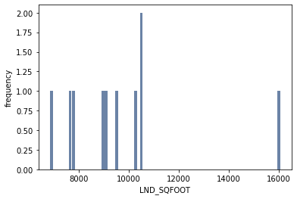
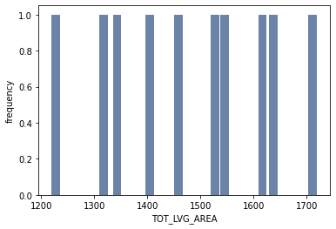
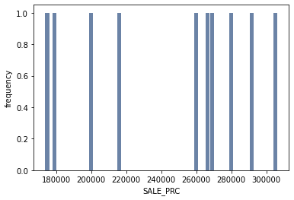
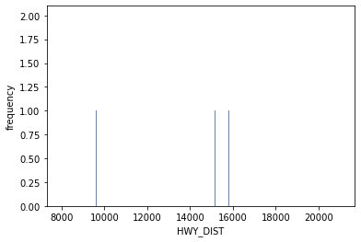
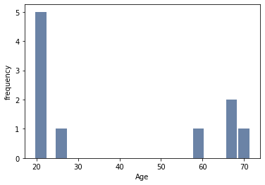
Include a histogram of each of the 5 variables

Slide 5
Mean, Mode, Spread, and Tails
LATITUDE LONGITUDE PARCELNO SALE_PRC LND_SQFOOT TOT_LVG_AREA \ |  |  |  |  |  |  |  |  |  | SPEC_FEAT_VAL RAIL_DIST OCEAN_DIST WATER_DIST CNTR_DIST SUBCNTR_DI \
0 25.749640 -80.431515 1.312402e+11 250000.0 7500.0 3079.0 |  |  |  |  |  |  |  |  |  | 0 0.0 50.0 13858.2 0.0 14557.6 14557.6
1 25.816591 -80.228887 3.022200e+12 NaN NaN NaN |  |  |  |  |  |  |  |  |  | 1 NaN NaN 15183.3 NaN 25074.0 25074.0
2 25.837536 -80.198387 3.031150e+12 NaN NaN NaN |  |  |  |  |  |  |  |  |  | 2 NaN NaN 21012.0 NaN 43025.9 37728.9
3 25.908080 -80.167954 3.049101e+12 NaN NaN NaN |  |  |  |  |  |  |  |  |  | 3 NaN NaN 22211.5 NaN 48378.1 44362.6
4 NaN NaN NaN NaN NaN NaN |  |  |  |  |  |  |  |  |  | 4 NaN NaN 24820.4 NaN 79187.6 44742.7
5 NaN NaN NaN NaN NaN NaN |  |  |  |  |  |  |  |  |  | 5 NaN NaN 28968.2 NaN 93953.7 45214.2
6 NaN NaN NaN NaN NaN NaN |  |  |  |  |  |  |  |  |  | 6 NaN NaN 33545.3 NaN NaN 60514.7
7 NaN NaN NaN NaN NaN NaN |  |  |  |  |  |  |  |  |  | 7 NaN NaN 34891.0 NaN NaN NaN
8 NaN NaN NaN NaN NaN NaN |  |  |  |  |  |  |  |  |  | 8 NaN NaN 42047.0 NaN NaN NaN
9 NaN NaN NaN NaN NaN NaN |  |  |  |  |  |  |  |  |  | 9 NaN NaN 55025.2 NaN NaN NaN
10 NaN NaN NaN NaN NaN NaN |  |  |  |  |  |  |  |  |  | 10 NaN NaN 61433.2 NaN NaN NaN
print(df.mean())
LATITUDE 2.572881e+01 LONGITUDE -8.032748e+01 PARCELNO 2.356496e+12 SALE_PRC 3.999419e+05 LND_SQFOOT 8.620880e+03 TOT_LVG_AREA 2.058045e+03 SPEC_FEAT_VAL 9.562493e+03 RAIL_DIST 8.348549e+03 OCEAN_DIST 3.169099e+04 WATER_DIST 1.196029e+04 CNTR_DIST 6.849033e+04 SUBCNTR_DI 4.111505e+04 HWY_DIST 7.723771e+03 age 3.066925e+01 avno60plus 1.492966e-02 month_sold 6.655828e+00 structure_quality 3.513997e+00
print(df.mode())

Slide 6
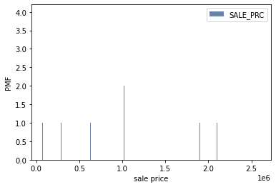
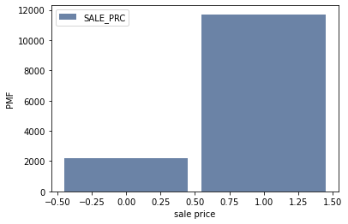
compare two scenarios in your data using a PMF
SALE_PRC_hist = thinkstats2.Hist(df['SALE_PRC'].head(100), label='SALE_PRC')
pmf = SALE_PRC_hist.Copy()
thinkplot.Hist(pmf)
thinkplot.Config(xlabel='sale price', ylabel='PMF')
SALE_PRC_hist = thinkstats2.Hist(df['SALE_PRC']>(200000), label='SALE_PRC')
pmf = SALE_PRC_hist.Copy()
thinkplot.Hist(pmf)
thinkplot.Config(xlabel='sale price', ylabel='PMF')

Slide 7
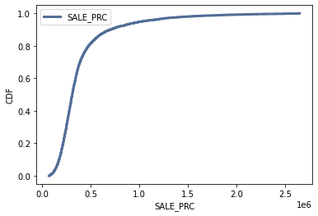
Create 1 CDF with one of your variables
cdf = thinkstats2.Cdf(df['SALE_PRC'], label='SALE_PRC')
thinkplot.Cdf(cdf)
thinkplot.Config(xlabel='SALE_PRC', ylabel='CDF', loc='upper left’)
This shows 90% of the house prices are more then 500k

Slide 8
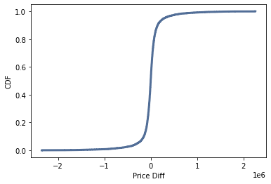
Plot 1 analytical distribution and provide your analysis

Slide 9
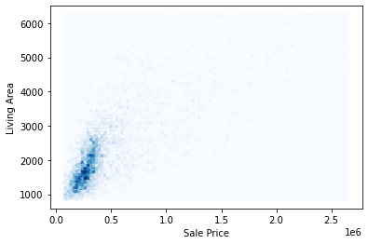
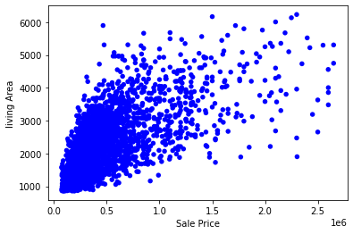
Create two scatter plots comparing two variables and provide your analysis on correlation and causation
def SampleRows(df, nrows, replace=False):
indices = np.random.choice(df.index, nrows, replace=replace)
sample = df.loc[indices]
return sample
sample = SampleRows(df, 5000)
SALE_PRC, TOT_LVG_AREA = sample.SALE_PRC, sample.TOT_LVG_AREA
thinkplot.Scatter(SALE_PRC, TOT_LVG_AREA, alpha=1)
thinkplot.Config(xlabel='Sale Price',
ylabel='living Area',
legend=False)
thinkplot.HexBin(SALE_PRC, TOT_LVG_AREA)
thinkplot.Config(xlabel='Sale Price',
ylabel='Living Area',
legend=False)
SALE_PRC, TOT_LVG_AREA = sample.SALE_PRC, sample.TOT_LVG_AREA
Cov(SALE_PRC, TOT_LVG_AREA)
101
Corr(SALE_PRC, TOT_LVG_AREA)
0.675651785547371
SpearmanCorr(SALE_PRC, TOT_LVG_AREA)
0.6989034519024762
This shows more correlation between living area and sale price at the lower end where as on the other end its more scattered.

Slide 10
Conduct a test on your hypothesis
sample = SampleRows(dfNew, 2)
sample1 = SampleRows(dfNew, 3)
data = sample.SALE_PRC.values,sample1.SALE_PRC.values
data
ht = DiffMeansPermute(data)
pvalue = ht.PValue()
Pvalue
0.095
The P-value is low and do not represent the whole dataset

Slide 11
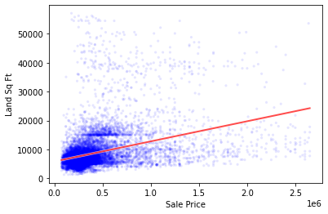
conduct a regression analysis
OLS Regression Results
Dep. Variable: | SALE_PRC | R-squared: | 0.132
Model: | OLS | Adj. R-squared: | 0.132
Method: | Least Squares | F-statistic: | 2115.
Date: | Fri, 04 Mar 2022 | Prob (F-statistic): | 0.00
Time: | 16:37:52 | Log-Likelihood: | -1.9526e+05
No. Observations: | 13932 | AIC: | 3.905e+05
Df Residuals: | 13930 | BIC: | 3.905e+05
Df Model: | 1
Covariance Type: | nonrobust
 | coef | std err | t | P>|t| | [0.025 | 0.975]
Intercept | 2.364e+05 | 4349.770 | 54.341 | 0.000 | 2.28e+05 | 2.45e+05
LND_SQFOOT | 18.9739 | 0.413 | 45.991 | 0.000 | 18.165 | 19.783
Notes: [1] Standard Errors assume that the covariance matrix of the errors is correctly specified. [2] The condition number is large, 1.83e+04. This might indicate that there are strong multicollinearity or other numerical problems

